Slide 1
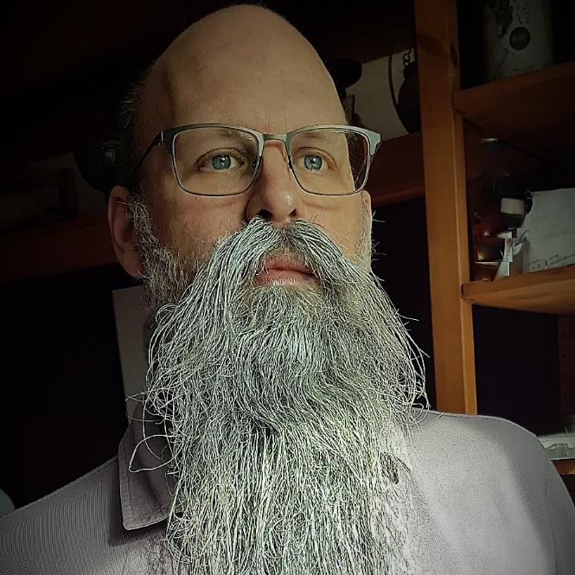
Rob Sewell
Notebooks For The DBA
Consultant
MVP and Beard Twizzler
@SqlDbaWithBeard
beard.media/book – 40 % code twitsewe40

Slide 2
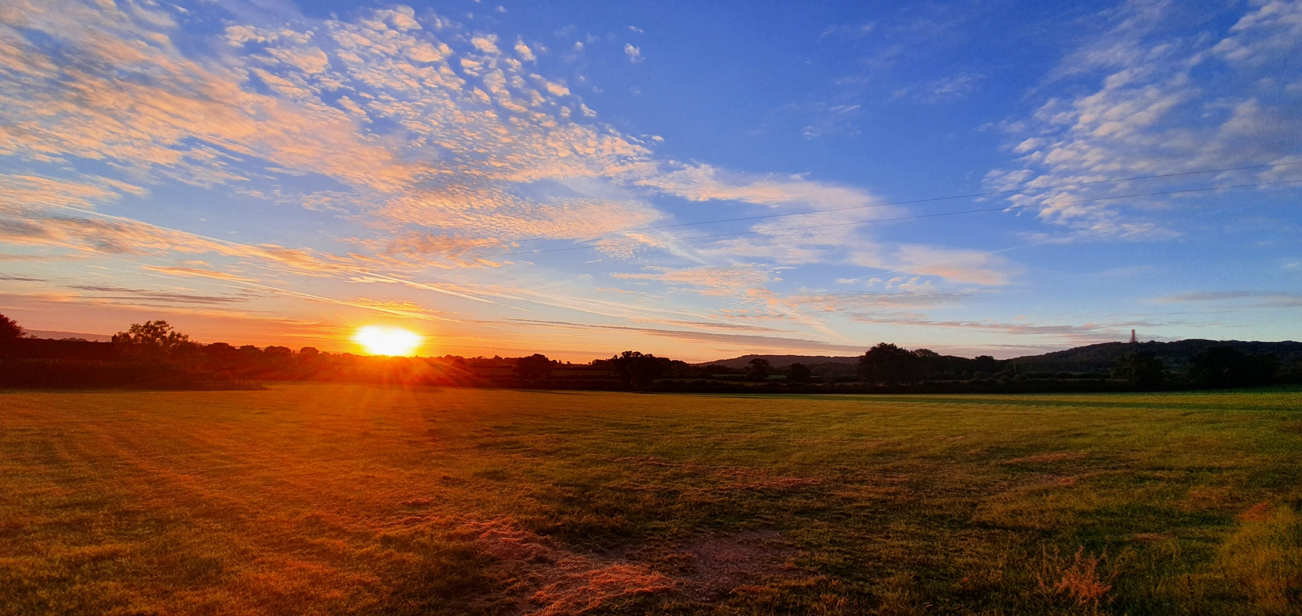

Not This Wellington!

Slide 3
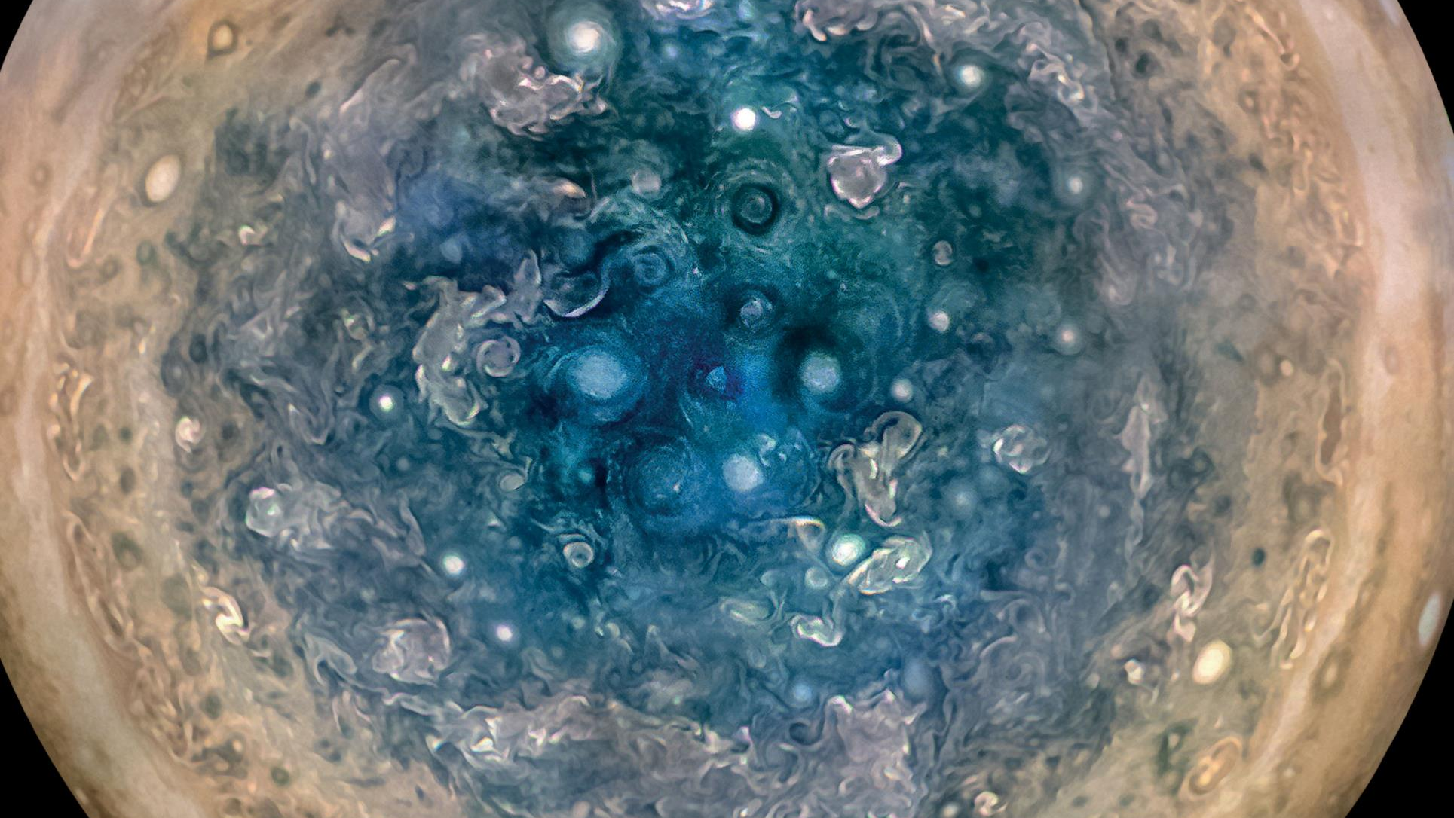

Slide 4
First, the names comes from the planet Jupiter. We wanted to pick a name that evoked the traditions and ideas of science.
Jupyter
@SQLDBAWithBeard blog.robsewell.com Rob Sewell beard.media/book

Slide 5
Jupyter
First, the names comes from the planet Jupiter. We wanted to pick a name that evoked the traditions and ideas of science.
Second, the core programming languages supported by Jupyter are Julia, Python and R. While the name Jupyter is not a direct acronym for these languages, it nods its head in those directions. In particular, the "y" in the middle of Jupyter was chosen to honor our Python heritage. See the logos of these languages in the languages folder of this repo.
https://github.com/jupyter/design/wiki/Jupyter-Logo
@SQLDBAWithBeard blog.robsewell.com Rob Sewell beard.media/book

Slide 6
Jupyter
Second, the core programming languages supported by Jupyter are
Julia, Python and R.
While the name Jupyter is not a direct acronym for these languages, it nods its head in those directions.
In particular, the "y" in the middle of Jupyter was chosen to honor our Python heritage.
Third, Galileo was the first person to discover the moons of Jupiter. His publication on the moons of Jupiter is an early example of research that includes the underlying data in the publication. This is one of the core ideas and requirements for scientific reproducibility. Reproducibility is one of the main focuses of our project.
https://github.com/jupyter/design/wiki/Jupyter-Logo
@SQLDBAWithBeard blog.robsewell.com Rob Sewell beard.media/book

Slide 7
Jupyter
Third, Galileo was the first person to discover the moons of Jupiter. His publication on the moons of Jupiter is an early example of research that includes the underlying data in the publication.
This is one of the core ideas and requirements for scientific reproducibility. Reproducibility is one of the main focuses of our project.
https://github.com/jupyter/design/wiki/Jupyter-Logo
@SQLDBAWithBeard blog.robsewell.com Rob Sewell beard.media/book

Slide 8
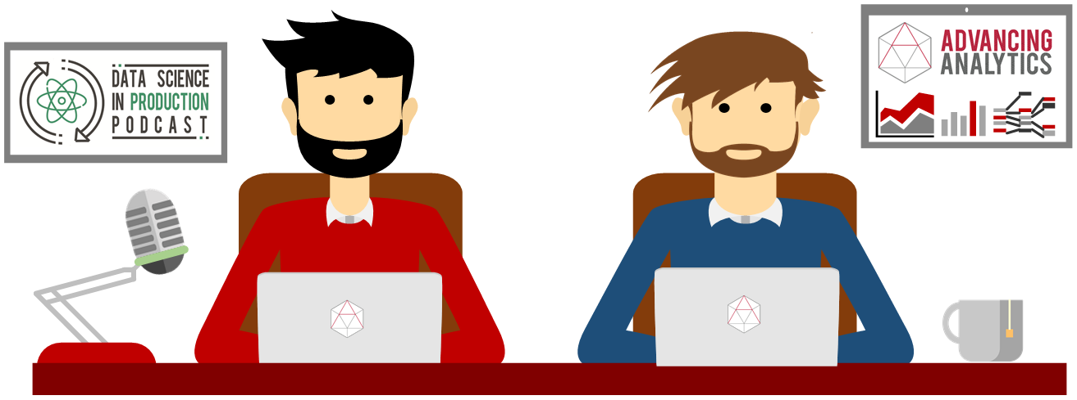
What is a Jupyter Notebook?
Originally for Data Scientists
@SQLDBAWithBeard blog.robsewell.com Rob Sewell beard.media/book

Slide 9

@SQLDBAWithBeard blog.robsewell.com Rob Sewell beard.media/book

Slide 10
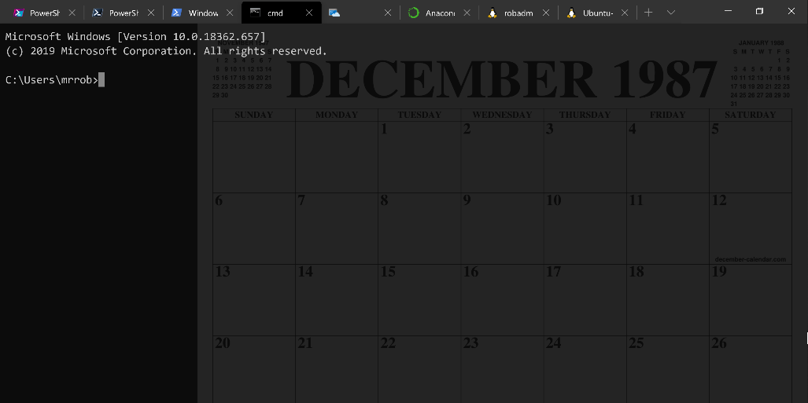
Running Queries
@SQLDBAWithBeard blog.robsewell.com Rob Sewell beard.media/book

Slide 11
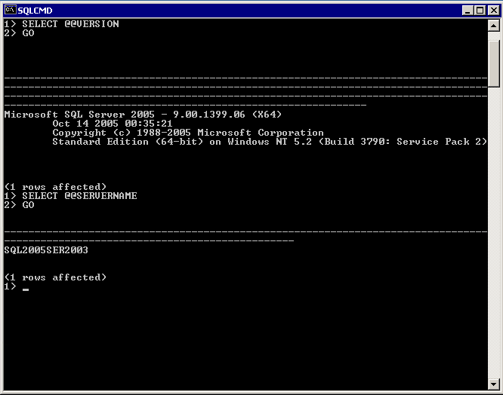
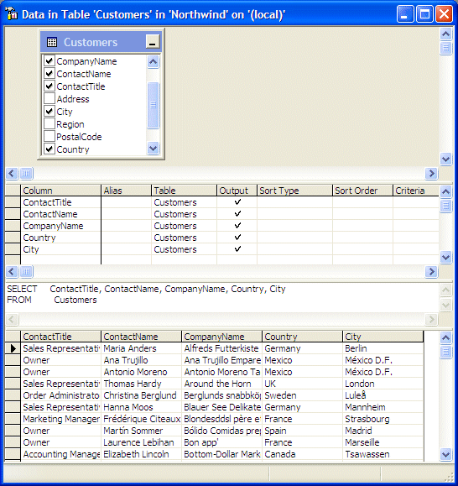
@SQLDBAWithBeard blog.robsewell.com Rob Sewell beard.media/book

Slide 12
Two and a Half Decades
@SQLDBAWithBeard blog.robsewell.com Rob Sewell beard.media/book

Slide 13
Uh, Houston, we've had a problem
https://en.wikipedia.org/wiki/Houston,_we_have_a_problem
@SQLDBAWithBeard blog.robsewell.com Rob Sewell beard.media/book

Slide 14
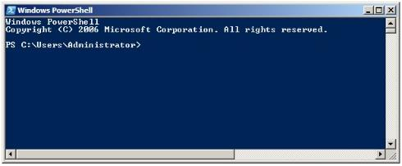
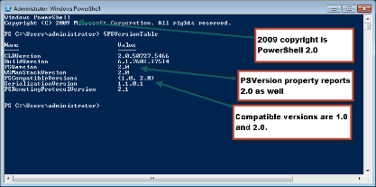
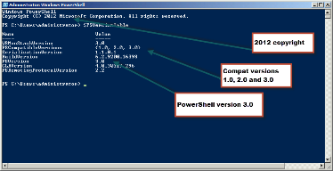
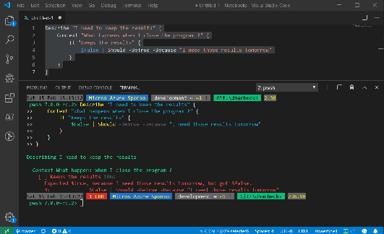
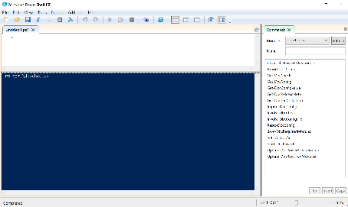
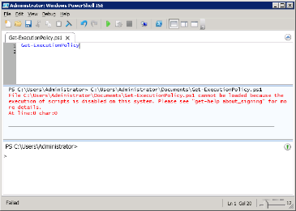
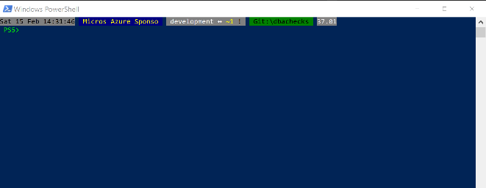
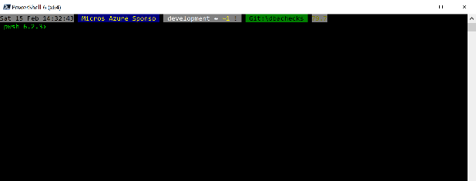
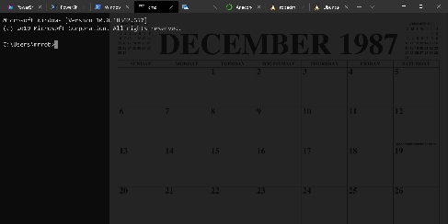
Without some effort………..

Slide 15
Without some effort………..
@SQLDBAWithBeard blog.robsewell.com Rob Sewell beard.media/book

Slide 16
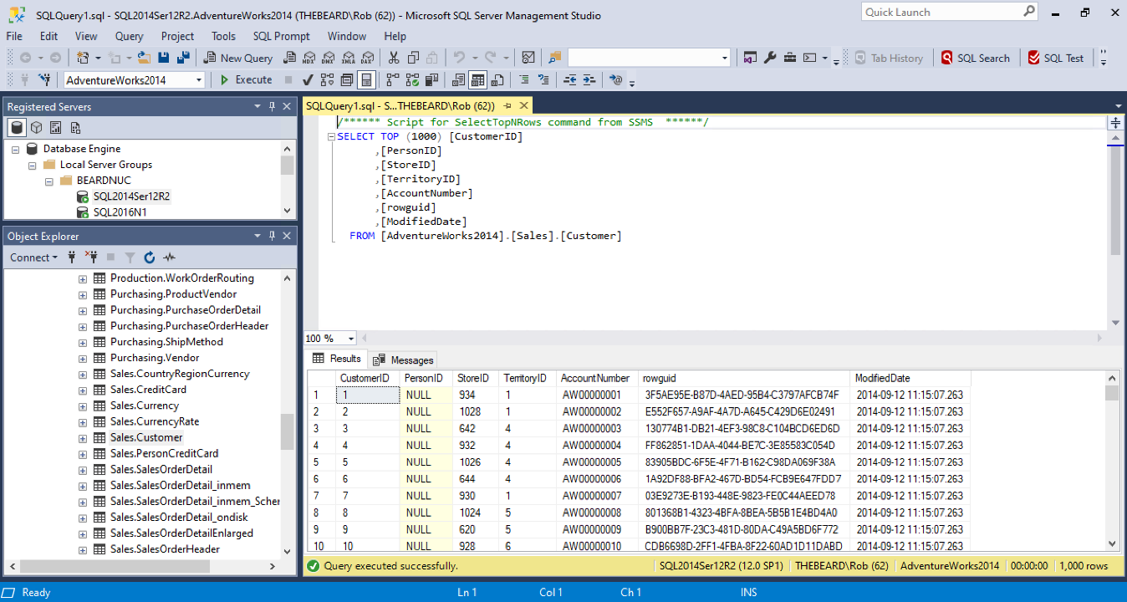

Slide 17
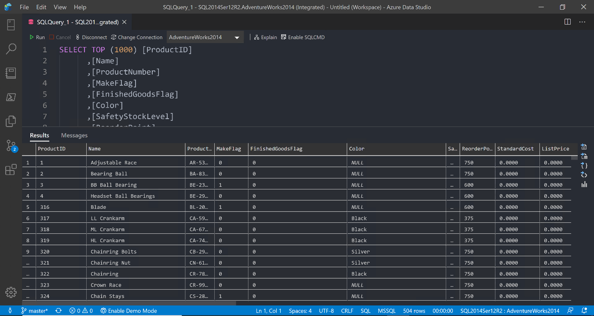

Slide 18
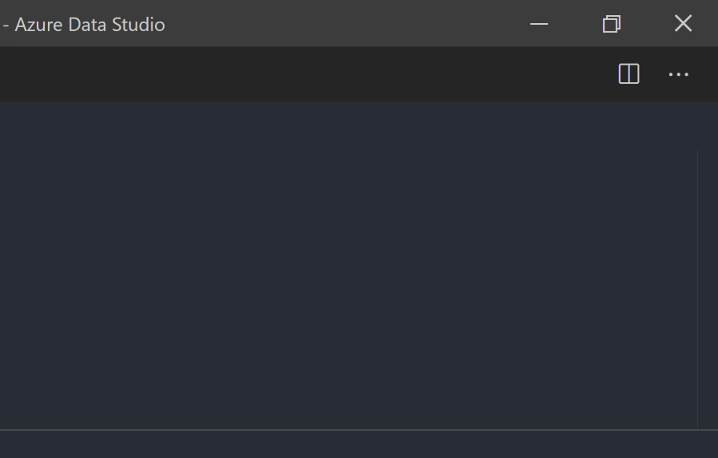
@SQLDBAWithBeard blog.robsewell.com Rob Sewell beard.media/book

Slide 19
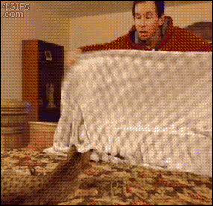
@SQLDBAWithBeard blog.robsewell.com Rob Sewell beard.media/book

Slide 20

@SQLDBAWithBeard blog.robsewell.com Rob Sewell beard.media/book

Slide 21
ALL
GONE
@SQLDBAWithBeard blog.robsewell.com Rob Sewell beard.media/book

Slide 22
What is a Jupyter Notebook?
Originally for Data Scientists

Slide 23
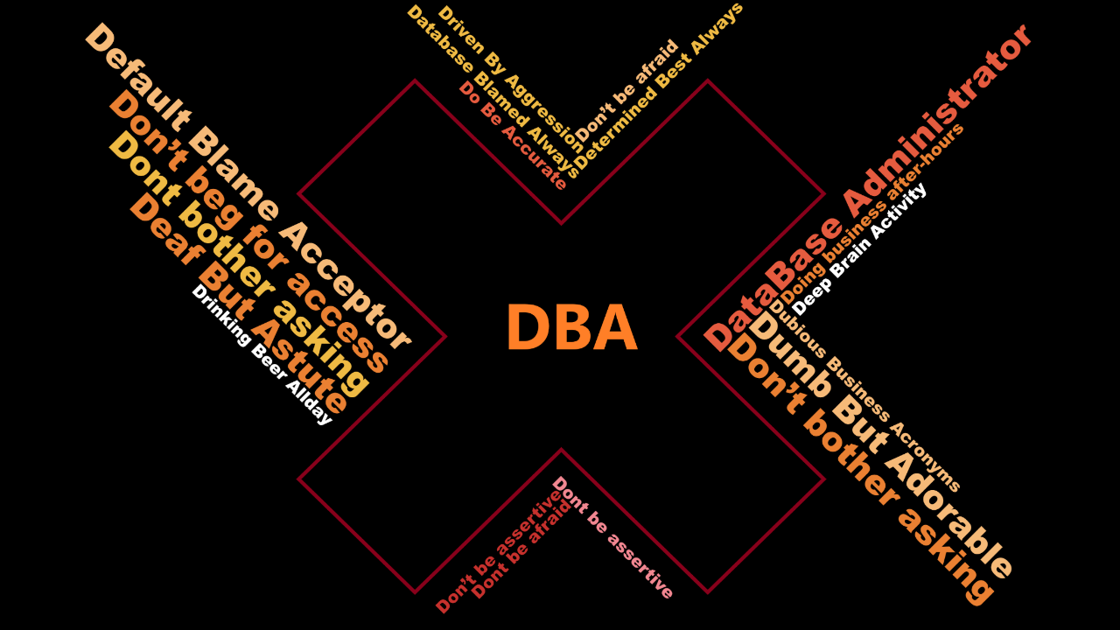

Slide 24
What is a Jupyter Notebook?
Document that can contain text, code, images and query results
@SQLDBAWithBeard blog.robsewell.com Rob Sewell beard.media/book

Slide 25
What is a Jupyter Notebook?
Document that can contain text, code, images and query results
@SQLDBAWithBeard blog.robsewell.com Rob Sewell beard.media/book

Slide 26





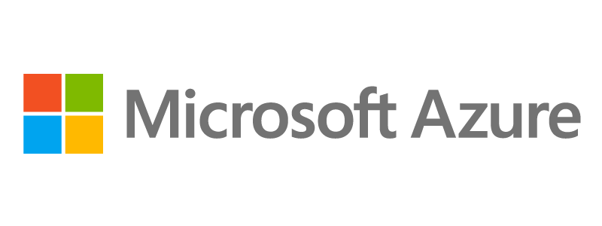



Sponsors
Track
Event
@SQLDBAWithBeard blog.robsewell.com Rob Sewell beard.media/book
Notes:
If you think, that a SQL Saturday is a nice possibility to learn from and network with fellow SQL Server enthusiasts FOR FREE,
I just ask you one thing: Visit the sponsor booths and chat with the sponsors!
They are covering the expenses for each and every of you, with is around EUR 60 …

Slide 27
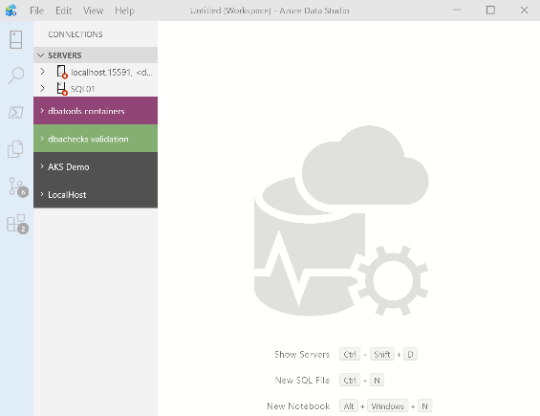
What’s Azure Data Studio ?
Cross Platform desktop environment for Data Professionals
@SQLDBAWithBeard blog.robsewell.com Rob Sewell beard.media/book

Slide 28

So it’s only for Azure?
@SQLDBAWithBeard blog.robsewell.com Rob Sewell beard.media/book

Slide 29
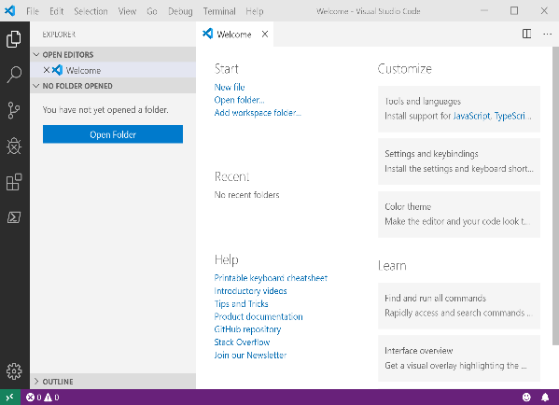
It Looks Like Visual Studio Code ?
@SQLDBAWithBeard blog.robsewell.com Rob Sewell beard.media/book

Slide 30
It Looks Like Visual Studio Code ?
@SQLDBAWithBeard blog.robsewell.com Rob Sewell beard.media/book

Slide 31

Time For A DEMO
@SQLDBAWithBeard blog.robsewell.com Rob Sewell beard.media/book

Slide 32
Teams Meetings
Azure BI - Join Microsoft Teams Meeting
Azure DB - Join Microsoft Teams Meeting
Cloud Development - Join Microsoft Teams Meeting
Data Platform - Join Microsoft Teams Meeting
Power BI - Join Microsoft Teams Meeting

